Slide 1

COURSE: DATA SCIENCE tOPIC: Statistics INSTRUCTOR: REEMA MEMON

Slide 2
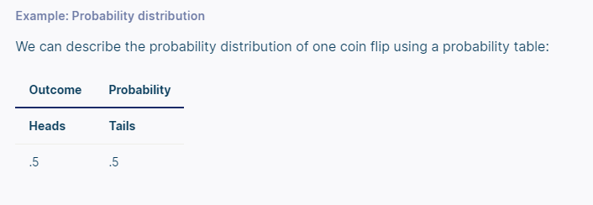
What is a probability distribution?
A probability distribution is a mathematical function that describes the probability of different possible values of a variable. Probability distributions are often depicted using graphs or probability tables.

Slide 3
The number of times a value occurs in a sample is determined by its probability of occurrence. Probability is a number between 0 and 1 that says how likely something is to occur:
0 means it’s impossible.
1 means it’s certain.
The higher the probability of a value, the higher its frequency in a sample.
More specifically, the probability of a value is its relative frequency in an infinitely large sample.

Slide 4
Infinitely large samples are impossible in real life, so probability distributions are theoretical. They’re idealized versions of frequency distributions that aim to describe the population the sample was drawn from.
Probability distributions are used to describe the populations of real-life variables, like coin tosses.

Slide 5
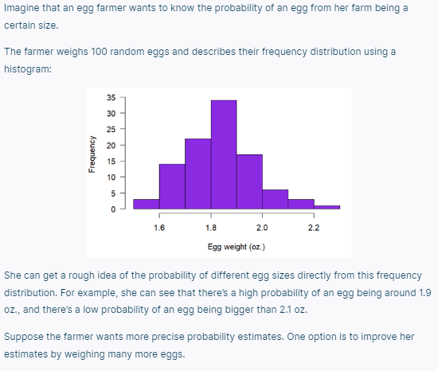

Slide 6
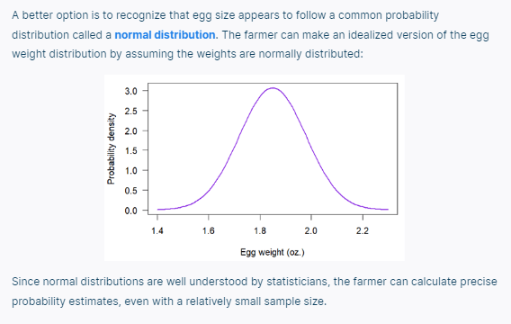

Slide 7
There are two types of probability distributions:
Discrete Probability Distributions
Continuous Probability Distributions
Discrete probability distributions
A discrete probability distribution is a probability distribution of a categorical or discrete variable.
Discrete probability distributions only include the probabilities of values that are possible. In other words, a discrete probability distribution doesn’t include any values with a probability of zero. For example, a probability distribution of dice rolls doesn’t include 2.5 since it’s not a possible outcome of dice rolls.
The probability of all possible values in a discrete probability distribution add up to one. It’s certain (i.e., a probability of one) that an observation will have one of the possible values.

Slide 8
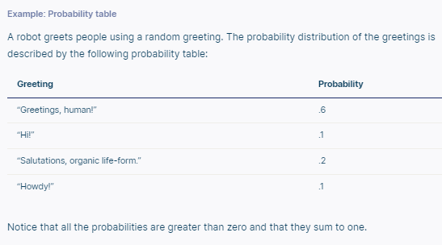
Probability tables
A probability table represents the discrete probability distribution of a categorical variable. Probability tables can also represent a discrete variable with only a few possible values or a continuous variable that’s been grouped into class intervals. A probability table is composed of two columns:
The values or class intervals.
Their probabilities.

Slide 9
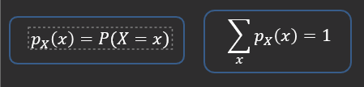
Probability Mass Function (PMF):
The probability mass function gives the probability that a discrete random variable will be exactly equal to a specific value. The probability mass function is only used for discrete random variables. the probability mass function assigns a particular probability to every possible value of a discrete random variable.
PMF Formula:

Slide 10
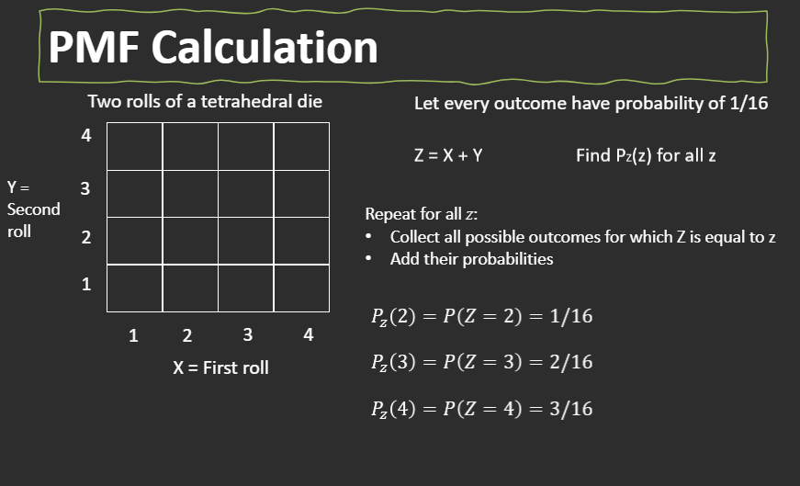

Slide 11
In binomial probability distribution, the number of ‘Success’ in a sequence of n experiments, where each time a question is asked for yes-no, then the outcome is represented either with success/yes/true/one (probability p) or failure/no/false/zero (probability q = 1 − p).
A single success/failure test is also called a Bernoulli trial or Bernoulli experiment, and a series of outcomes is called a Bernoulli process.
For n = 1, i.e. a single experiment, the binomial distribution is a Bernoulli distribution.

Slide 12
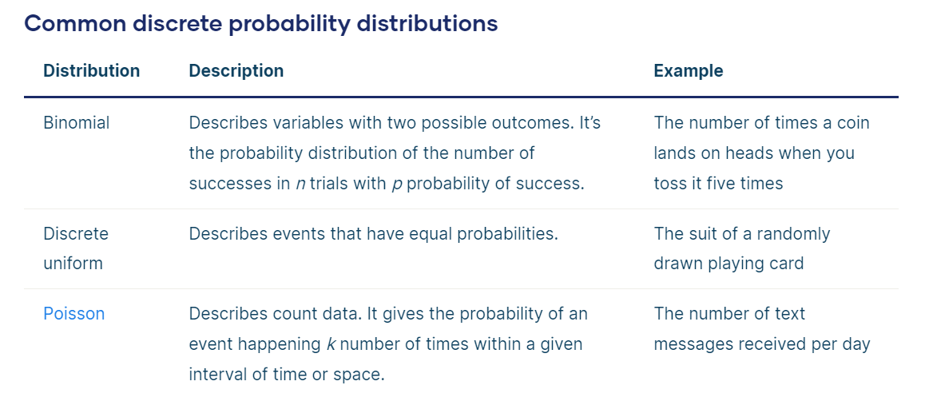

Slide 13
Continuous probability distributions
A continuous probability distribution is the probability distribution of a continuous variable.
A continuous variable can have any value between its lowest and highest values. Therefore, continuous probability distributions include every number in the variable’s range.
The probability that a continuous variable will have any specific value is so infinitesimally small that it’s considered to have a probability of zero. However, the probability that a value will fall within a certain interval of values within its range is greater than zero.

Slide 14
Probability Density Function (PDF):
A probability density function (PDF) is a mathematical function that describes a continuous probability distribution. It provides the probability density of each value of a variable, which can be greater than one.
A probability density function can be represented as an equation or as a graph.
In graph form, a probability density function is a curve. You can determine the probability that a value will fall within a certain interval by calculating the area under the curve within that interval.
A cumulative distribution function is another type of function that describes a continuous as well as discrete probability distribution.

Slide 15
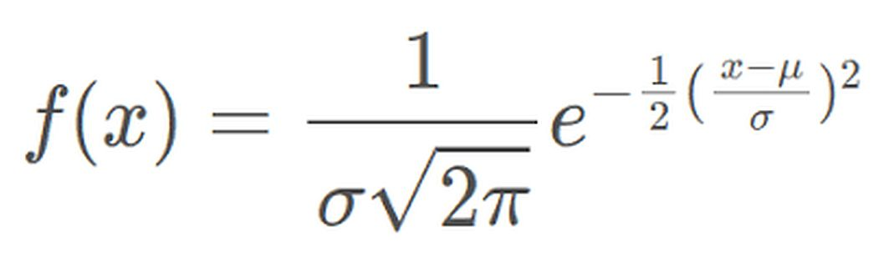
The probability density function of the normal distribution is given by the formula:

Slide 16
